Slide 1
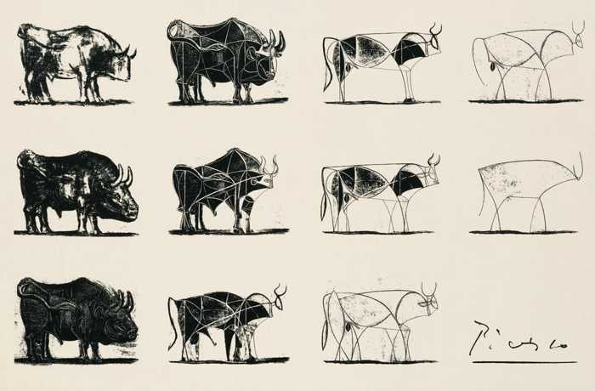

Slide 2
Pablo Picasso’s Le Taureau
“The Bull”, or the Zodiac sign Taurus in English.
A series of eleven lithographs created in 1945. It depicts the bull at various stages of abstraction, starting with a fairly realistic depiction and ending with nothing but a few lines.

Slide 3
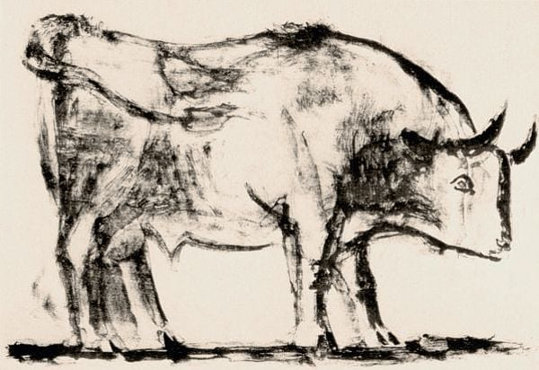

Slide 4
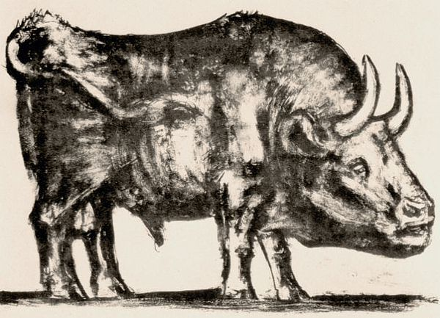

Slide 5
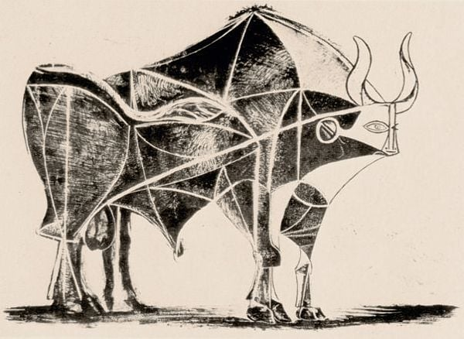

Slide 6
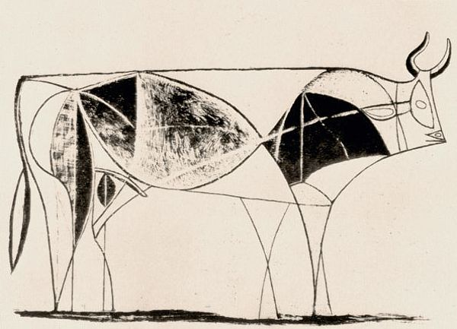

Slide 7
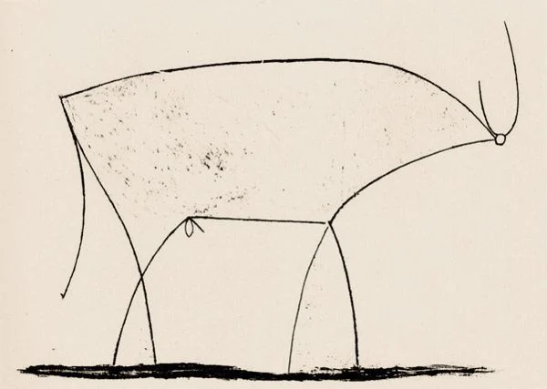

Slide 8
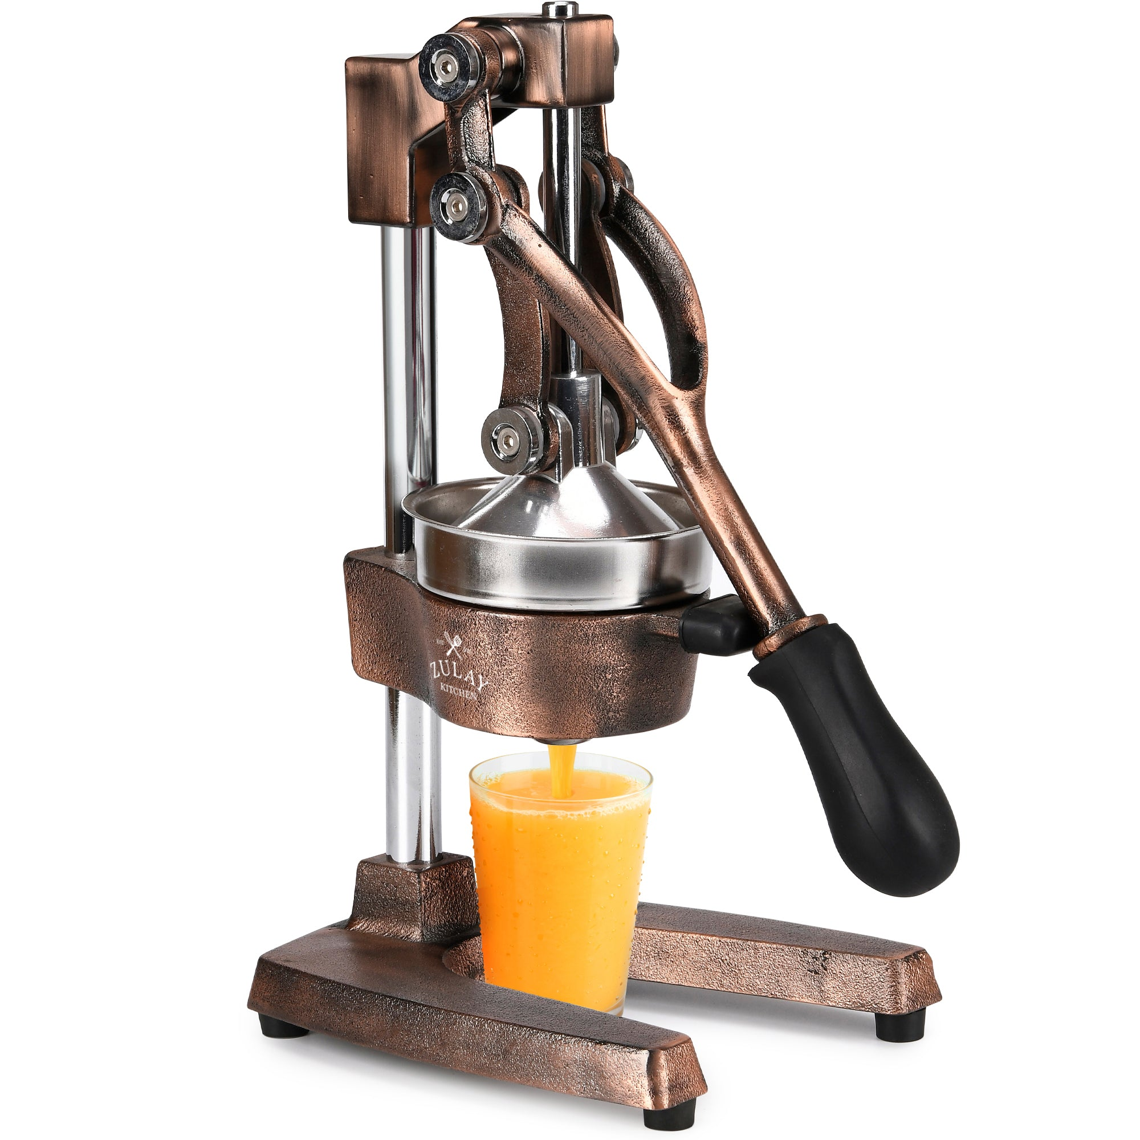

Slide 9


Slide 10


JUICER

